Slide 1
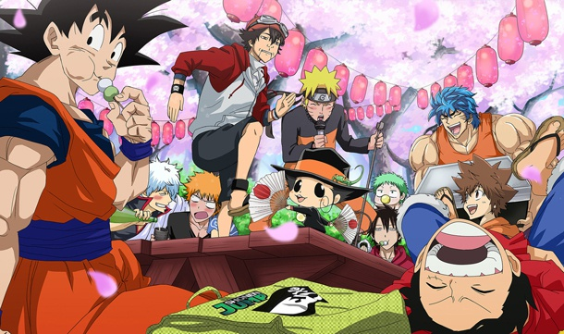
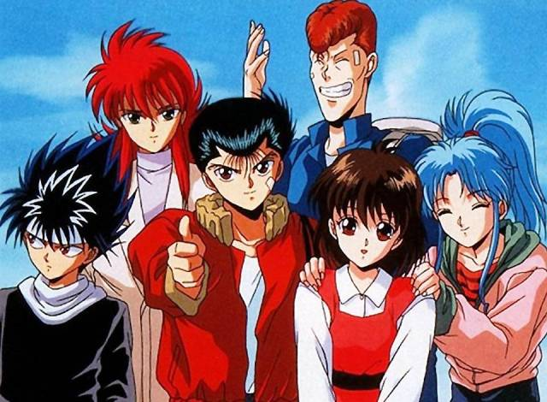
JAPANESE ANIMATION
LA’NEIR HAINES

Slide 2
Introduction
While today’s Japanese Anime are characterized by huge creativity and complexity, they have a long history that dates back to 1917. Anime was born as rudimentary drawing on the primitive walls or on what is well known as “manga” e.g. the like of toba-ehon. Toba-ehon was a book consisting of drawings accompanying a story featuring the lives of ordinary people in the Edo Period (1603-1867).
Japanese Anime

Slide 3
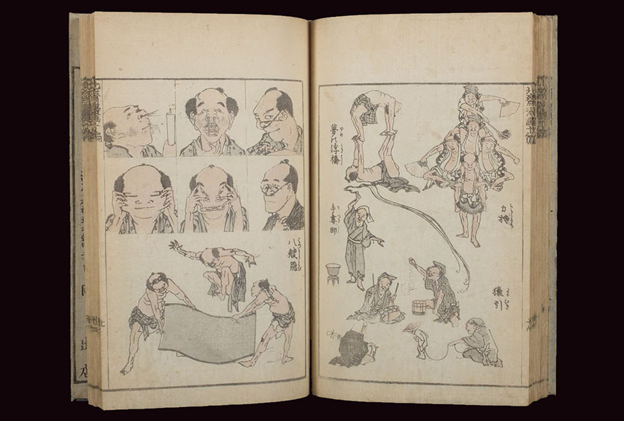
1603-1867
The rough sketches seen in the toba-ehon involved subtle puns or comic situations.
According to Brenner, toba-ehon among other manga books such as the Hokusai Manga books of drawings by the famous ukiyo-e artist Hokusai set the foundation for Japanese anime.
Japanese artists used these kind of paintings to spread their culture or even tell stories about their traditions and social norms.
Inside toba-ehon manga book. It is the first example of the comics form in history. Image Source: harvardartmuseums.org
Notes:
It is also important to note here that toba-ehon illustrated stories (otogizoshi) often based on folklore and legends, epic war tales (gunky Monogatari). However, anime produced in the 20th Century shows how artists had been trying to incorporate traditional stories and motifs in a new modern form.

Slide 4
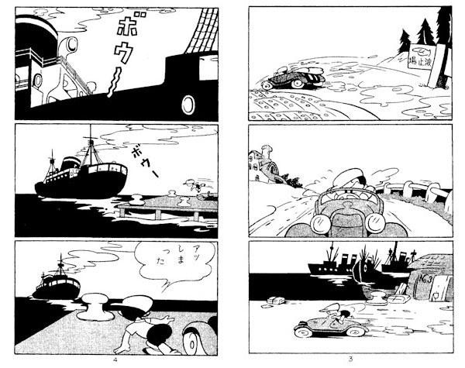
Based on the ideas of the drawing found in toba-ehon , artists immersed themselves with new developments where they started to produce comic drawings that were linked together to create a chain sequence and over time, this became a new type of anime art form (Bouissou). The characters and themes used in the drawings immensely varied. Some were illustrations of adventure, love, war, history and so forth which were all important in diffusion and spreading of the Japanese culture.
(漫画)
The above manga was an ink brushed illustrated print. It was first published in 1947 under the title (New Treasure Island)
Notes:
Some manga were also used to criticize the Japanese government in 1930s. For example, the image shown in this slide was created by Tezuka who debuted with a comic book in 1947, “New Treasure Island” that was an Akahon (a cheap "Red Book"). Akahon was a niche industry that provided entertainment to the poor children of post-war Japan.

Slide 5
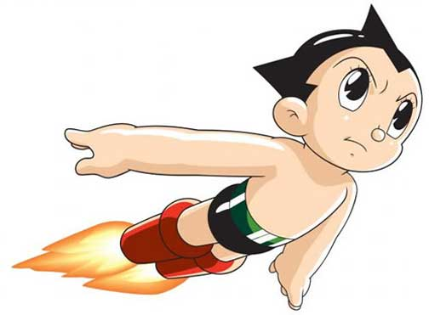
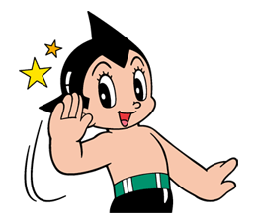
Modern Anime
1960-1970
In 1963, Tetsuwan Atomu (the Japanese name for Astroboy, which also means “Mighty Atom”) came out as a television series. It was first produced as manga that featured in the Weekly Shonen Magazine from 1952 to 1968 and was later produced as the first Japanese anime in 1962 (MacWilliamss). The character astroboy was a robot that wished to be a real boy.
Through the character (astroboy), Tezuka explored Japanese culture by addressing human conflict, cruelty and consciousness by demonstrating that people require the capacity to learn in order to acquire knowledge.
Notes:
The astroboy anime became the foundation of modern Japanese animation.

Slide 6
Bibliography
Bouissou, Jean-Marie. "Manga: A historical overview." Manga: An anthology of global and cultural perspectives (2010): 17-33.
Brenner, Robin E. Understanding manga and anime. Greenwood Publishing Group, 2007.
MacWilliams, Mark W. Japanese visual culture: explorations in the world of manga and anime. Routledge, 2014.

